Slide 1
Caption Metrics - comparing caption metrics to user ratings of captions
Tian Wells & Dylan Christoffels
Notes:
Dylan

Slide 2
Research Question:
How accurately do the WER/ACE models assess the quality of live TV captions as perceived by users when compared to each other?
Notes:
Dylan

Slide 3
Prior Research on Caption Comprehension
Prior research focused on caption comprehension.
Studies from countries had participants watch TV shows.
There were two groups: one with captions and one without.
The results showed how important captions are.
DHH people often prefer verbatim captions over edited captions, even though they take longer to read. This is because they prefer to have more accurate and comprehensible captions over shorter ones.
This differs with different levels of literacy
Notes:
Dylan
Verbatim is regular conversation captioning
Edited is shorter version to speed up.
Literacy is able to read and write

Slide 4
Different Caption Metrics
WER (Word Error Rate)
Penalizes words that are incorrect, due to a mistake in one of the three categories: insertion, deletion, or replacement.
Errors are not weighted based on severity
ACE
Evaluates ASR-generated captions specifically for DHH people
Unlike WER, distinguishes between harmful and less harmful errors
Uses word predictability score to measure keywords in a text, and semantic distance to approximate deviation
Notes:
tian

Slide 5
Testing setup and design
Participants viewed 10 live TV clips, two times each. For each of the 10 sets:
Rate caption quality and the difference between the two captions
View the clip with “error” captions
Rate the caption quality and identify any caption errors
View the same clip with fully accurate captions
We calculated the correlation of participant ratings with WER and ACE.
Notes:
Dylan

Slide 6
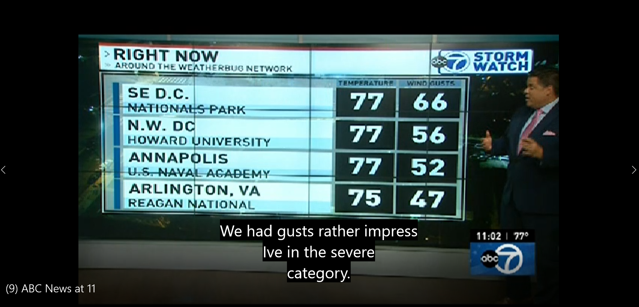
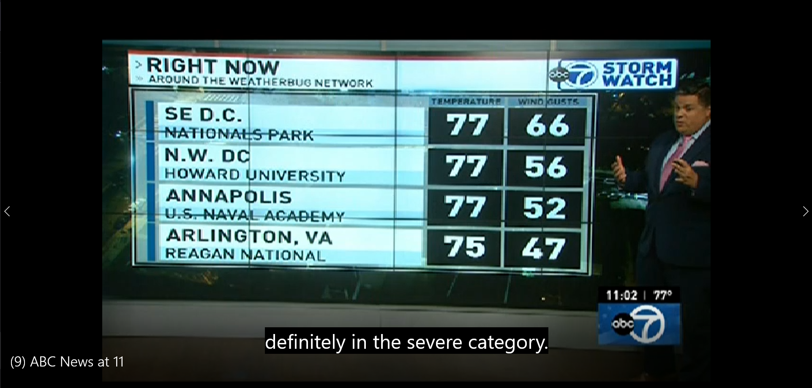
ERROR
ACCURATE
Notes:
Dylan

Slide 7
Demographic Analysis
We had 15 participants in total. Of the 15...
Hearing Identification
6 Deaf Participants
6 Hearing Participants
3 Hard of Hearing Participants
Language Preference
66.6% use spoken English most frequently
33.3% use ASL most frequently
Notes:
Dylan

Slide 8
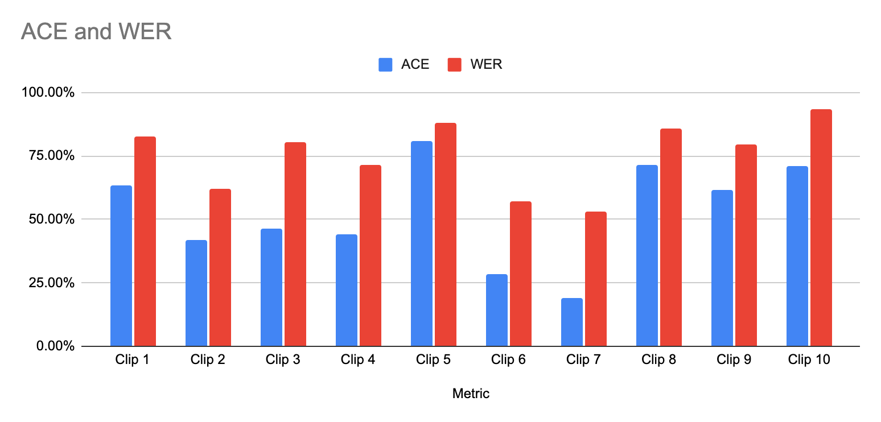
Caption Metrics Data
The table shows the metrics data from ACE and WER for each stimuli clip, where higher percentages indicate higher accuracy.
WER has greater accuracy scores across all clips
Clip ten shows the greatest discrepancy between ACE and WER.
Clip 5 also has a large discrepancy.
These discrepancies also appeared in user ratings of the clips
Notes:
Tian

Slide 9
Participant Study Data
What data is accurate, credible, and useful?
The following questions best encapsulated caption quality, so we chose them for analysis
Question 1: “Do you feel you were able to fully understand the content of the error clip?” (1-7)
High numbers correspond to higher caption quality.
Question 2: “Comparing the original captions and accurate captions, how would you rate the differences between the two?” (1-7)
Low numbers correspond to lower caption quality.
Notes:
Dylan
higher score means the captions have higher quality

Slide 10
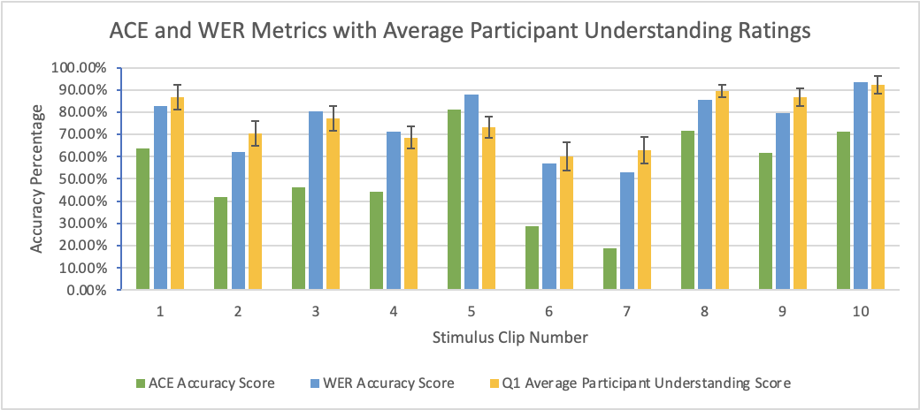
Comparing Metrics Data with Study Averages
Notice WER has higher accuracy scores overall.
Q1, regarding caption understanding, has more similar values with WER
Clip 5 is an outlier in Q1, because the average user score is closer to ACE than to WER in this instance
Notes:
Tian

Slide 11
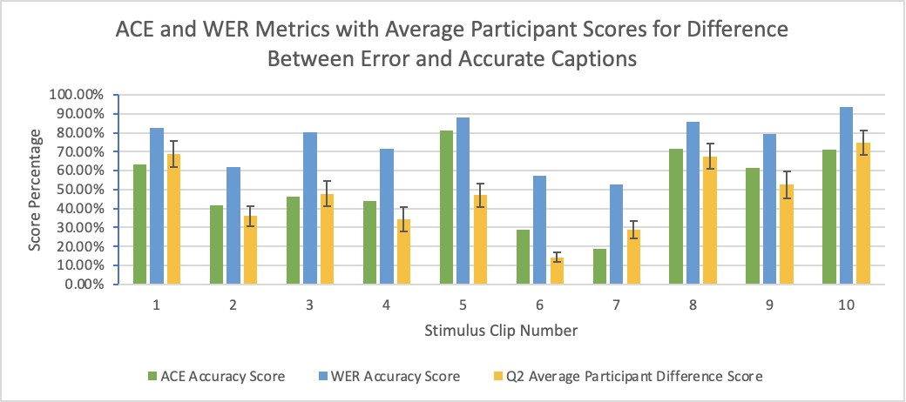
Comparing Metrics Data with Study Averages
Same as previous notice that WER has a higher accuracy scores overall.
Q2, regarding differences between error and accurate captions, has more similar average values with ACE.
Notes:
Tian

Slide 12
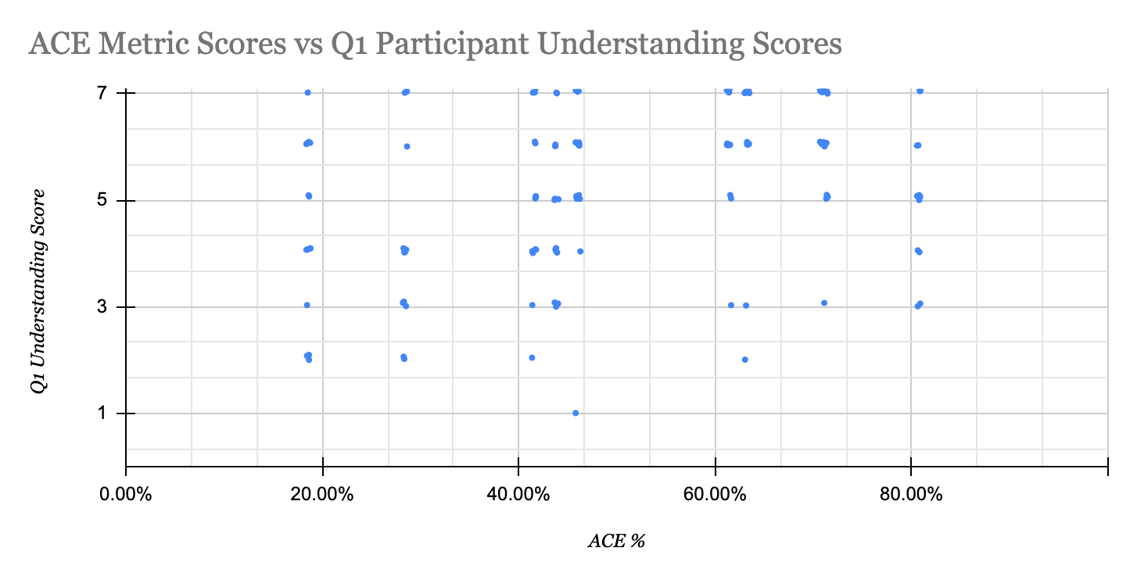
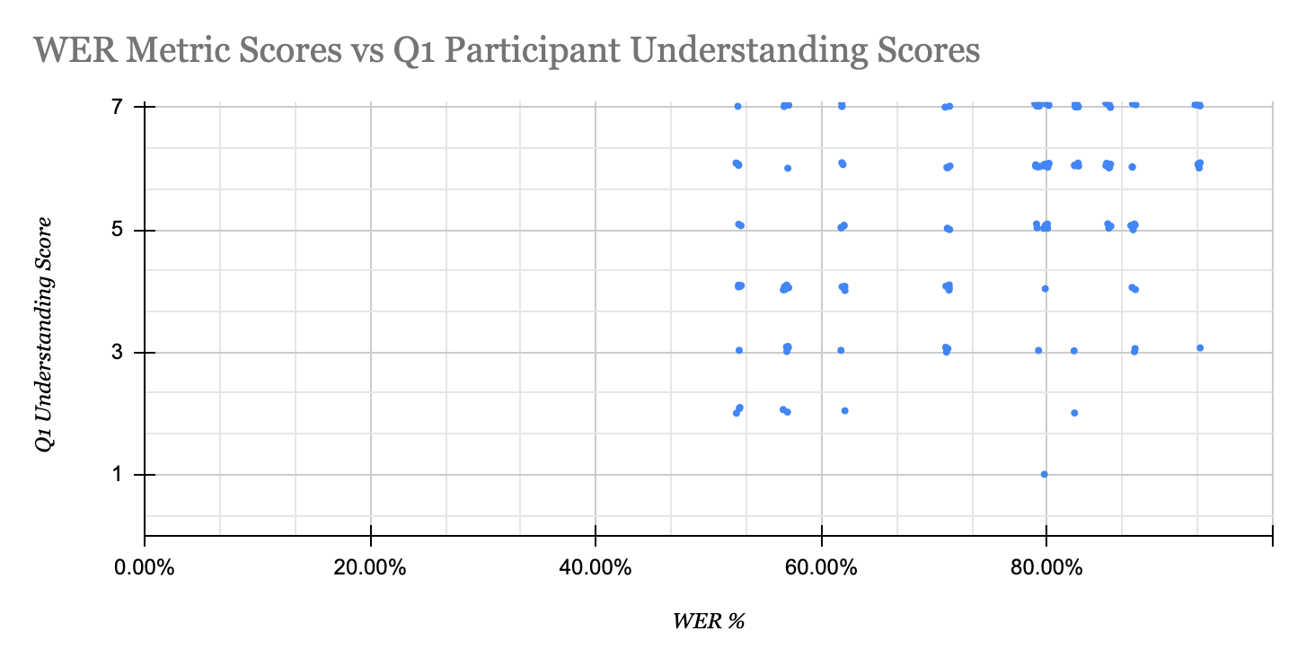
Comparing Metric Scores with Participant Scores for Question 1
We expected stronger correlations between participants ratings and the WER and ACE scores but responses are quite varied.
Notes:
Tian

Slide 13
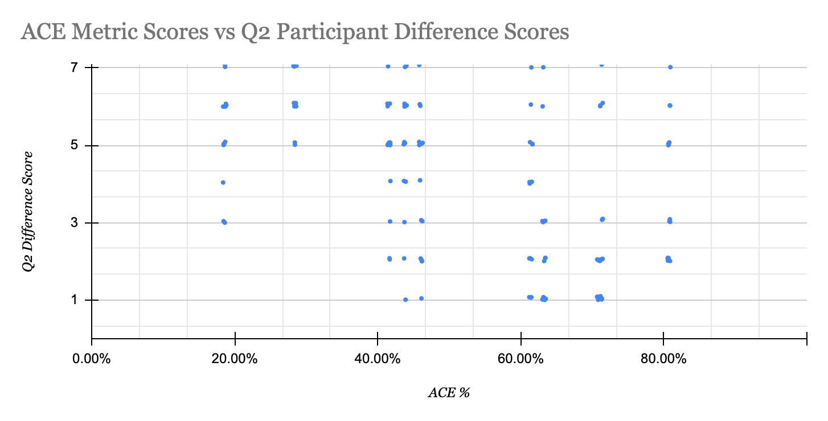
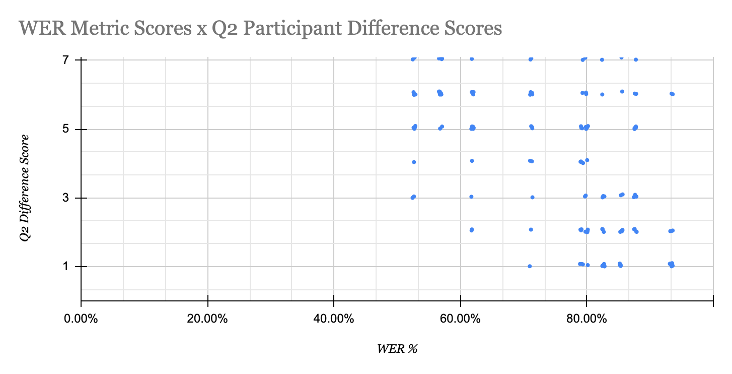
Comparing Metric Scores with Participant Scores for Question 2
We expected a stronger negative correlation for Q2, but again, responses are varied.
Notes:
Tian

Slide 14
Data and Analysis
The average understanding of the error stimuli clips was 5.37 out of 7 (Q1 data)
The ACE metric did not perform as well as WER with respect to Q1, but not significantly
Q1 responses show that participants mostly understood the stimuli
ACE scored all stimuli relatively low in accuracy
WER did not penalize errors as greatly and generated higher scores that seemed to slightly improve its performance
The previous 4 graphs show:
The left side of both Q1 and Q2 ACE scatterplots show especially low correspondence and high variability.
Lower ACE scores have contributed to less correlation between the ACE metric and participant responses in both Q1 and Q2.
Notes:
Tian

Slide 15
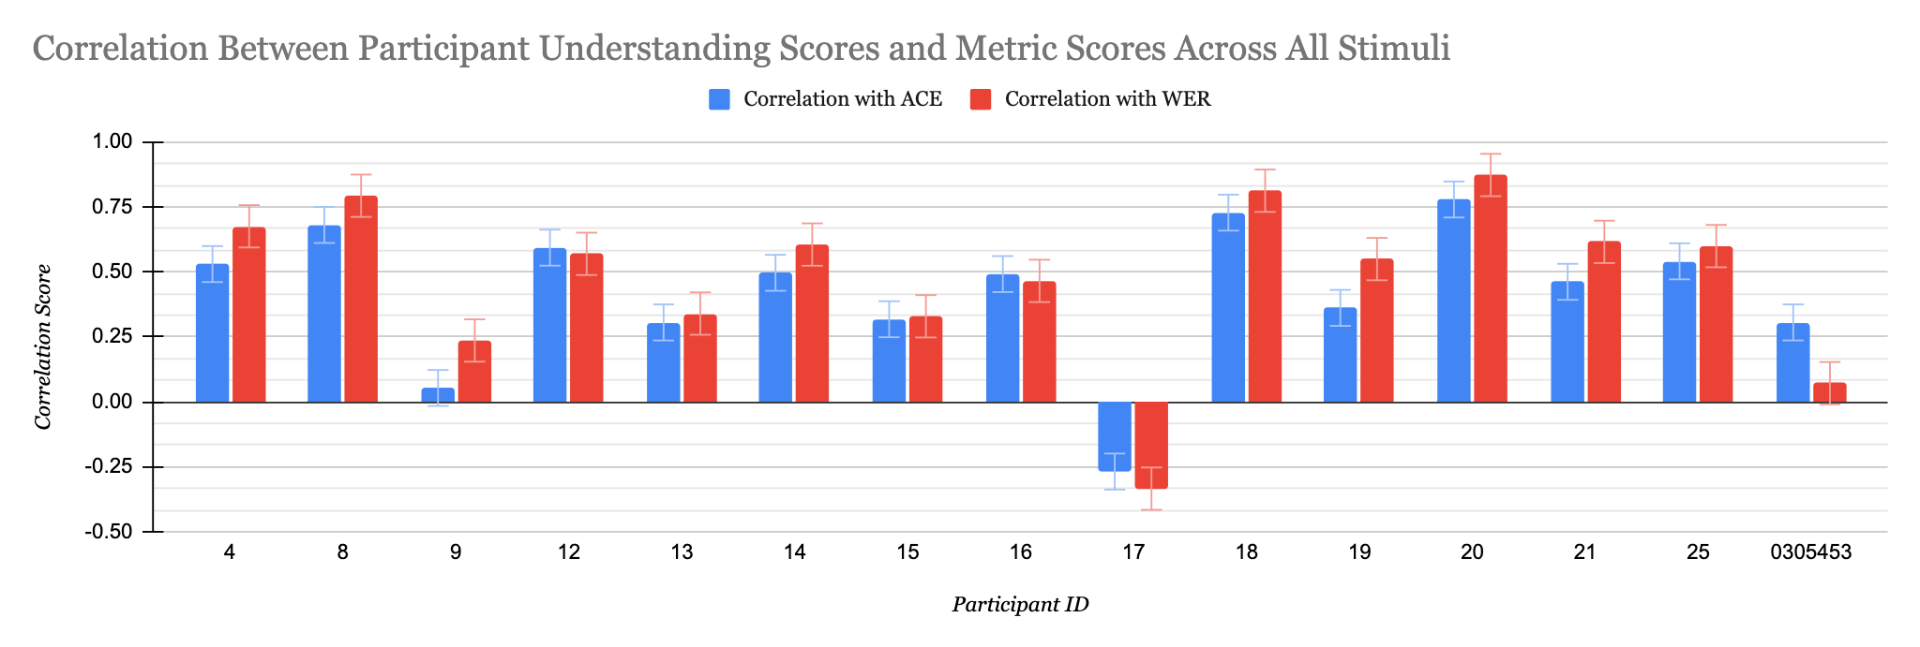
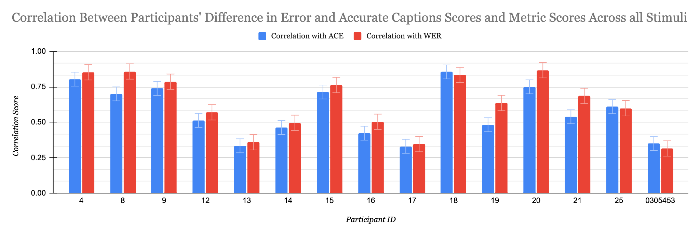
Looking at Metric-Participant Score Correlation
Q1
Q2
Notes:
Tian

Slide 16
T Test Analysis
Two T Tests were performed on the previous data:
One test comparing the WER and ACE correlation data for Q1
0.077
Significant difference
One test comparing the WER and ACE correlation data for Q2
0.0030
Insignificant difference
WER had a higher correlation with participant scores
T Test for understanding scores showed significance, but the means of each data set are still very similar
Notes:
Tian

Slide 17
Discussion and Analysis
Differences in ACE and WER can be attributed to their vastly different scoring methodologies
ACE’s inclusion of word weights, and WER’s lack thereof
ACE more precisely scores caption errors, which also contributes to its lower accuracy scores overall
ACE was designed specifically with deaf and hard of hearing people in mind. Our study includes deaf, hard of hearing, and hearing people
Notes:
Tian

Slide 18
Significance
Our study doesn’t support what we found in our literature review
A previous study found that ACE had a greater correlation with participant experiences than WER
Our study found the null hypothesis
TV clips may be a less suitable environment for ACE than the types of stimuli used by prior work
We discovered some flaws in the ACE metric that have not been mentioned in any previous studies
The ACE metric tended to score clips with lower accuracy than what was perceived by participants, which limited its ability to correlate strongly with participants’ scores.
Notes:
Tian

Slide 19
Limitations
Clarity issue in Question 3: “Accurate clip: After watching the 100% accurate captions, how would you rate the quality of the original captions from 1-7?”
Some people put rate 7 (excellent) after having watched the accurate captions, which is not what we expected. We think many have misunderstood the question.
Due to the difficulty of WWER calculations and time constraints, we were not able to include this metric in our study.
Caption quality is difficult to define, and even more so to research
The link between participants’ self-reported scores and caption quality is not a direct one.
Notes:
Dylan
scores that the participants give don't necessarily define quality, not a guaranteed accurate measure
- How should future studies expand on your study? What else should future research look at?
- What is the significance of your study in the grand scheme of things? Why are your findings important?
- Limitations
- No study is perfect, what is missing from your study and what could it have benefitted from?
- Typically at the end of your conclusion
- you can create a sub-heading for limitations.

Slide 20
Conclusions
Data collected from our two study questions, each relating to a different aspect of caption quality, help illustrate where each metric performs strongly and where each fails.
Future work:
Analyzing how the ACE metric weighs errors in captions and how scores can result in overestimation.
Expanding this work to other metrics such as WWER and NER.
Importance:
No study participants reported having a perfect experience with captions in the past.
With improved analysis of caption metrics, we can inform future revisions of metrics and the updated caption metrics can go on to better assess and improve captioning for all that use it.
Notes:
Dylan
Conclusion: Drive home your main findings here in a concluding paragraph or two. Discuss/reiterate the significance of this research: what should people do with this information? Include call to action.

Slide 21
References
[1] Jang, P. J., & Hauptmann, A. G. (1999, June). Improving acoustic models with captioned multimedia speech. In Proceedings IEEE International Conference on Multimedia Computing and Systems (Vol. 2, pp. 767-771). IEEE.
[2] Block, M. H., & Okrand, M. (1983). Real-time closed-captioned television as an educational tool. American Annals of the Deaf, 128(5), 636-641.
[3] Apone, T., Brooks, M., & O’Connell, T. (2010). Caption Accuracy Metrics Project. Caption Viewer Survey: Error Ranking of Real-time Captions in Live Television News Programs. Boston.
[4] Al Amin, A. (2020). Audio-Visual Caption Evaluation Metric for People who are Deaf and Hard of Hearing.
[5] Apone, T., Botkin, B., Brooks, M. & Goldberg, L. (2011). Research into Automated Error Ranking of Real-time Captions in Live Television News Programs. The Carl and Ruth Shapiro Family National Center for Accessible Media at WGBH (NCAM).
[6] Kafle, S., & Huenerfauth, M. (2017, October). Evaluating the usability of automatically generated captions for people who are deaf or hard of hearing. In Proceedings of the 19th International ACM SIGACCESS Conference on Computers and Accessibility (pp. 165-174).
Notes:
None

